Slide 1

A Lightweight Health Risk Analysis System for the Elderly using Polysomnography Data
Guided by,
Geetha Lekshmi V .
Anuvind MP (AM.EN.U4AIE22010)
R S Harish Kumar (AM.EN.U4AIE22042)

Slide 2
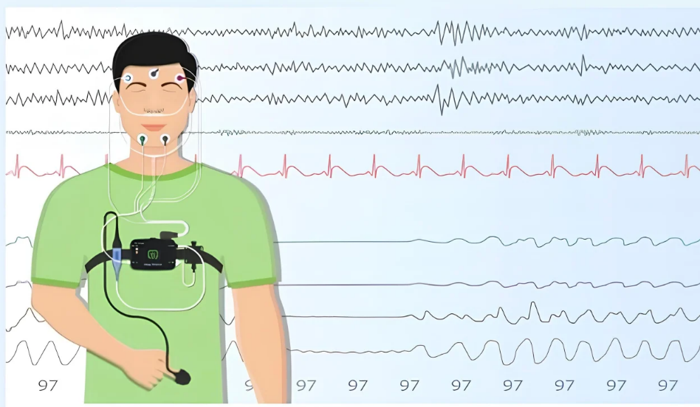
Introduction
Aging populations face increasing risk of chronic diseases.
Automated system using sleep analysis facilitates timely interventions.
Increasing healthcare costs and morbidity.
Polysomnography (PSG) provides rich multi-modal signals that capture these sleep-related physiological changes.
This can significantly reduce healthcare costs and improve quality of life for aging adults.
Notes:
Cite the work that detects dementia, Parkinson’s using polysomnography data..
Early detection through sleep analysis facilitates timely interventions – of cardiovascular disease. Dementia ,Parkinson’s???
Introduction should align with disease risk prediction, which are the systems currently using polysomnograpy data and what are the limitations?
Corrections/Modifications
Problem with sleep in elderly?? Statistics
Relation of sleep with cardio vascular disease, any info from papers??give ref also

Slide 3
Problem Definition
Polysomnography data encodes vital physiological signatures of cardiovascular, respiratory, and mental health disorders prevalent in aging populations, offering unprecedented opportunities for early disease detection. However, traditional manual PSG analysis is time-consuming, costly, and often unavailable in resource-limited regions, delaying early diagnosis.
Existing AI-based PSG models are computationally intensive and unsuitable for deployment on low-end devices. Therefore, there is a need for a lightweight, efficient, and accurate model that can operate in constrained healthcare settings.

Slide 4
Objectives
Design a lightweight deep learning framework optimized for low-end hardware using Neural Architecture Search (NAS) with Differentiable Architecture Search (DARTS) to achieve high accuracy under low computational cost (FLOPs).
Mitigate demographic bias and improve cross-dataset generalization by unifying diverse polysomnography datasets representing heterogeneous elderly populations.
Analyze sleep patterns in the elderly to identify markers of cardiovascular, respiratory, and mental health conditions.
Provide an assistive technology for early intervention of various diseases in the elderly cohorts, since the prevalence of diseases is increasing in the aging population.
Project title

Slide 5
Literature Review Summary (Table)
Reference | Target Disease & Health Risks | Advantages | Limitations and Challenges
Nie et al., 2025(SleepFounder) | Multi-organ diseases: Parkinson’s,GERD, Heart Failure, CVD death, Sleep Apnea | "Zero-Burden" Potential: Designed to work with home-based sensors (BCG)and handles missing modalities effectively. | Model Complexity: Relies on a complex hierarchical architecture (ResNet + Transformer), which may be computationally heavy for low-end mobile deployment
Thapa et al.,2025 (SleepFM) | PheWAS (1000+ conditions): Including Death, Heart Failure, Dementia, Stroke, and CKD | Channel-Agnostic: Can handle varying numbers and types of input channels,making it robust to different recording setups. | Resource Intensive: Requires massive datasets (500k+ hours) for pre-training and substantial computational power, limiting direct edge deployment
Fallmann & Chen, 2018 | Hypertension,Diabetes, Sleep Apnea, Kidney Disease | Non-Invasive: Uses simple wrist-worn data; suitable for long-term monitoring outside clinical settings. | Lower Accuracy: Performance (0.62–0.81 accuracy) is generally lower than modern multimodal deep learning approaches; older architecture
He et al., 2025 | CVD Outcomes: CVD mortality,incident hypertension, atrial fibrillation. | Interpretable Risk Scores: Generates projection scores correlating with specific disease phenotypes; removes need for manual sleep staging. | Latency: While efficient for profiling, the hybrid ResNet-Transformer architecture is still relatively large compared to lightweight, mobile-first models.
Blanchard et al.,2021 | CVD & Mortality: 6-year cardio-vascular morbidity and all-cause mortality risk. | Lightweight & Deployable: highly interpretable, fast, and uses simple sensors suitable for routine clinical or home use | Limited Depth: May miss subtle neurological or fine-grained physiological patterns captured by deep learning on full waveforms.

Slide 6
Research Gap
Deployment Accessibility: State-of-the-art sleep AI models require expensive high-performance computing infrastructure, making them inaccessible for deployment in resource-constrained settings
Multi-Cohort Generalization : Existing systems exhibits potential bias due to underrepresented population cohorts in the training data, hence, a generalized model is needed to mitigate ​‍​‌‍​‍‌bias.
Neural Architecture Search and model compression techniques remain unexplored in PSG data based health screening, leaving the accuracy-efficiency trade-off unoptimized for edge deployment.
Mental health disorders : 15-20% of elderly are affected by depression and other mental ailments. Thus a need for an automated framework capable of detecting such comorbidities is at large.

Slide 7
Dataset Description
Dataset Survey
Multi-Dataset Analysis: Multiple publicly available PSG datasets were surveyed to capture diverse populations and acquisition protocols.
Cleveland Family Study (CFS)
Wisconsin Sleep Cohort (WSC)
MrOS Sleep Study (MROS)
Sleep Heart Health Study (SHHS)
Multi-Ethnic Study of Atherosclerosis (MESA)
Apnea Positive Pressure Long-term Efficacy Study (APPLES)

Slide 8
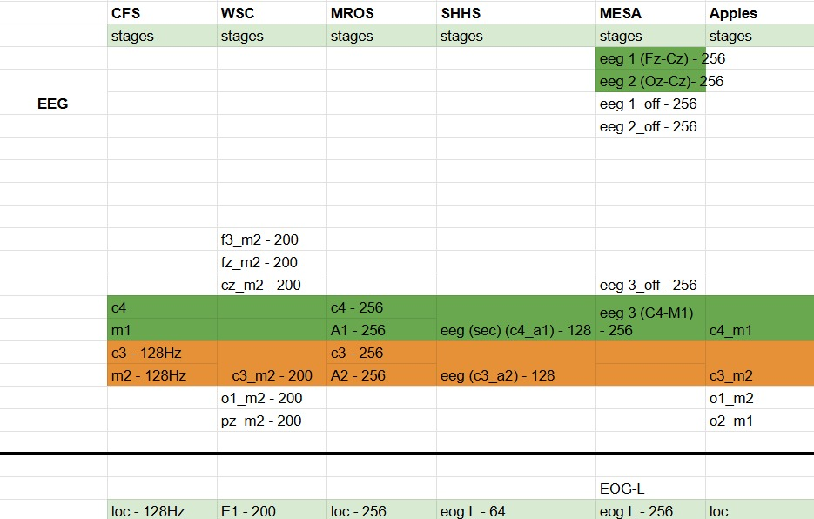
Data Harmonization
Cross-dataset channel comparison identified seven common physiological signals present across all datasets:
EEG (C3-M2)
EOG
ECG
EMG
Leg Movement
Thoracic Movement
SpO₂

Slide 9
Target Diseases
Twenty diseases highly prevalent in elderly populations were selected across three clinical cohorts - cardiovascular, cerebrovascular/mental health, and respiratory.
Cardiovascular Diseases
Myocardial Infarction
Angina
High Blood Pressure
Cardiovascular Disease
High Cholesterol
Congestive Heart Failure
Irregular Heartbeat
Stroke
Ischemia Pattern
Cerebrovascular & Mental Health Disorders
Cerebrovascular Disease
ADHD
Anxiety
Behaviour Disorder
Depression
Hypertension
Respiratory Diseases
Asthma
Bronchitis
Hay Fever
Pneumonia
Sinus Disease

Slide 10
Dataset Description
Disease Selection Criteria: Selected conditions represent high-prevalence comorbidities in elderly populations, validated through clinical expert consultation to ensure relevance for health monitoring.
Diseases with very low counts were removed from each category. (TIA, Tourettes, Emphysema, …)

Slide 11
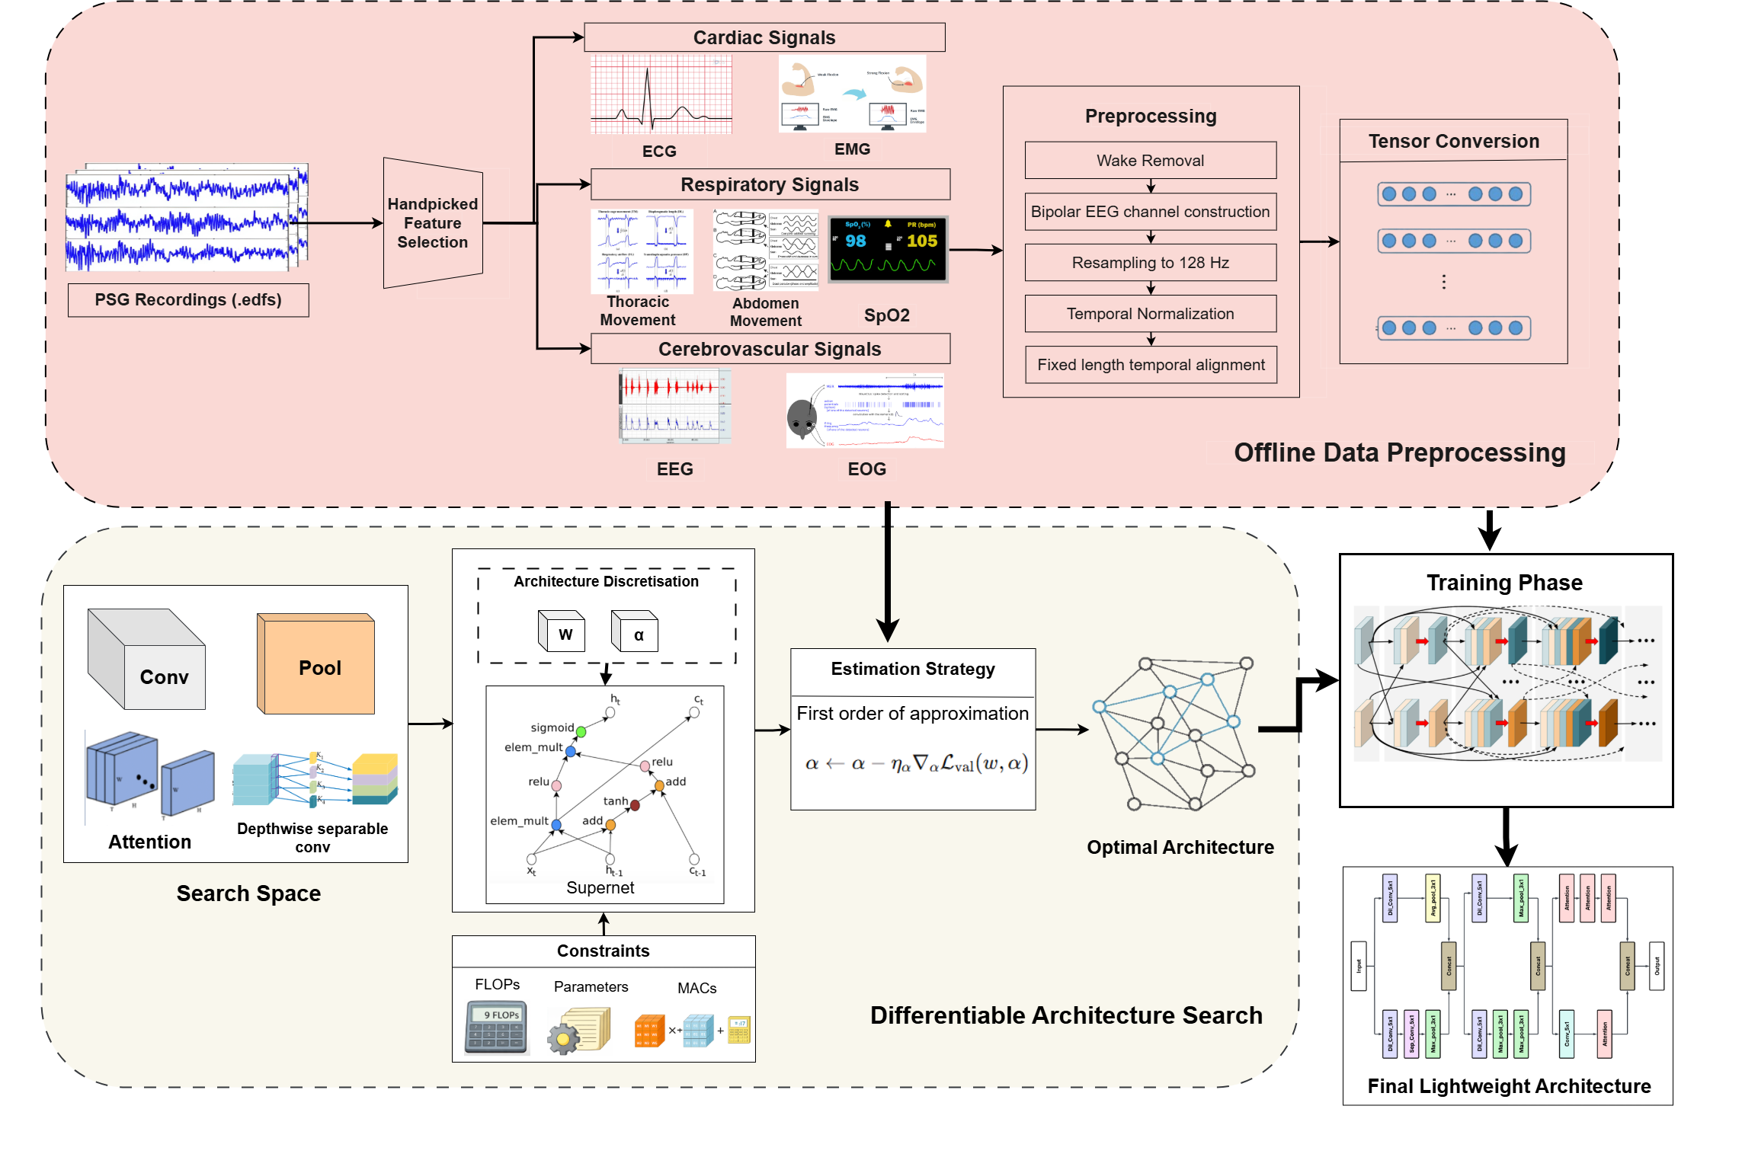
Methodology Pipeline

Slide 12
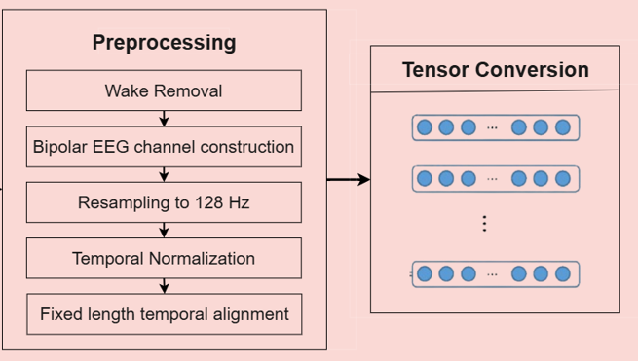
Methodology Pipeline
1. Data Preprocessing
Wake Removal: Initial wake periods removed using hypnogram annotations to focus on physiological sleep stages
Bipolar EEG Construction: C3-M2 channel reconstructed from differential signals (C3 - M2) to reduce artifacts
Signal Resampling: All 7 channels standardized to 128 Hz sampling frequency
Z-Score Normalization: Channel-wise normalization applied for numerical stability
Temporal Alignment: Signals interpolated to fixed length for uniform tensor dimensions
Tensor Conversion: EDF files converted to tensors for 50-100× faster loading during training

Slide 13
Methodology Pipeline (Contd..)
Neural Architectural Search (NAS)
NAS is an automated machine learning technique that systematically searches through a defined space of neural network architectures to discover optimal model designs for a specific task, eliminating manual architecture engineering.
Differentiable Architecture Search (DARTS)
DARTS transforms the discrete architecture search problem into a continuous optimization problem by using a weighted mixture of all candidate operations, enabling efficient gradient-based search through backpropagation instead of computationally expensive evolutionary or reinforcement learning methods.
Why DARTS? DARTS enables efficient architecture search on standard hardware through gradient descent, eliminating the massive computational requirements of RL and evolutionary strategies.

Slide 14
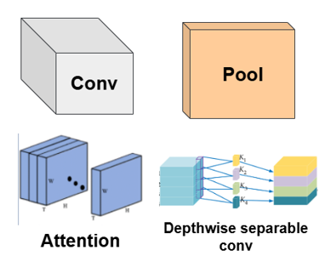
2. Search Space Definition
2.1 Architecture Configuration
Design Pattern: Cell-based structure with 3 stacked identical cells
Node Configuration: 2 intermediate nodes per cell for feature aggregation
Initial Channels: 24 channels (width parameter)
Graph Structure: Directed Acyclic Graph (DAG) with operations on edges
2.2 Candidate Operations
Conv (1×1, 3×1, 5×1)
Depthwise Sep Conv (3×1, 5×1)
Dilated Conv (3×1, 5×1, dilation=2)
Pooling (max, avg)
Attention (2-head)
Identity (skip)

Slide 15
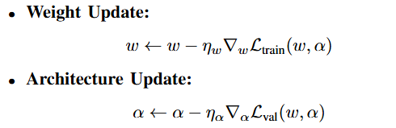
Methodology Pipeline (Contd..)
Supernet
An over-parameterized network that simultaneously embeds all candidate architectures from the search space, enabling efficient exploration without training each architecture separately.
Bi-level Optimization
A two-stage optimization strategy that simultaneously learns model weights (w) on training data and architecture parameters (α) on validation data.

Slide 16

Methodology Pipeline (Contd..)
Efficiency-Aware Constraints
Goal: Bias search toward computationally efficient architectures
Monitored Efficiency Metrics
FLOPs (Floating-Point Operations) - computational complexity
MACs (Multiply-Accumulate Operations) - arithmetic operations count
Parameters - model memory footprint
Soft Constraint Formulation:
Predefined Computational Budgets
B₁ = 5.0 × 10⁷ (50M FLOPs)
B₂ = 2.5 × 10⁷ (25M MACs)
B₃ = 5.0 × 10⁵ (0.5M parameters)

Slide 17
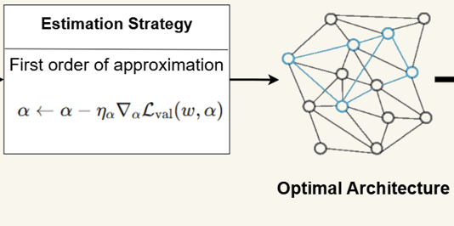
Architecture Discretization
Second-Order Approximation:
Computes unrolled model for more accurate gradient estimation
Requires computing Hessian matrix
Computationally expensive - creates computational bottleneck
First-Order Approximation (Our Choice):
Direct gradient computation without unrolling
Significantly faster and memory-efficient
Trades minor accuracy for computational efficiency
Ideal for lightweight deployment on commodity hardware

Slide 18
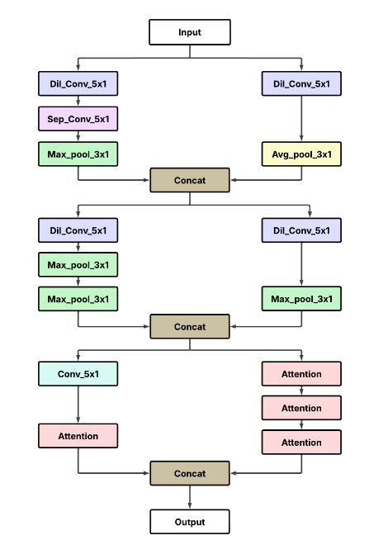
Optimal light-weight Architecture
Performance Metrics :
Metric | Value
Parameters | 170904 (0.17M)
Flops | 167.8M
Macs | 82.62M
Validation accuracy | 90.6%
This architecture was then trained and validated from scratch with the full dataset for 50 epochs

Slide 19
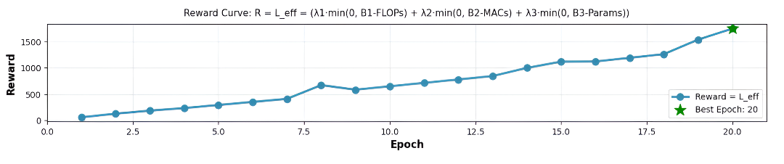
Performance Evaluations (NAS)
Reward Curve
Demonstrates steady reward improvement as NAS simultaneously optimizes accuracy and efficiency, converging to the best lightweight architecture by epoch 20

Slide 20
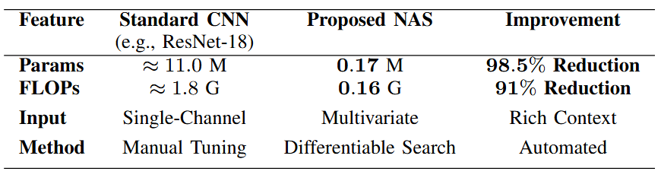
Performance Evaluations (NAS)
Comparison of our optimal architecture vs ResNet-18

Slide 21
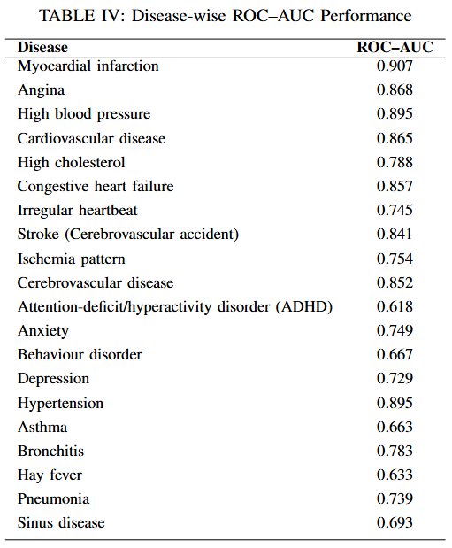
Performance Evaluations (Lightweight Architecture)
ROC (Receiver Operating Characteristic) Curve
ROC-AUC (Area Under Curve) - Overall classification performance

Slide 22
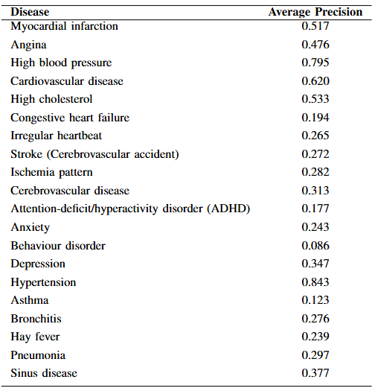
Performance Evaluations (Lightweight Architecture)
2. Precision-Recall (PR) Curves
Assesses trade-off between positive predictive value and sensitivity

Slide 23
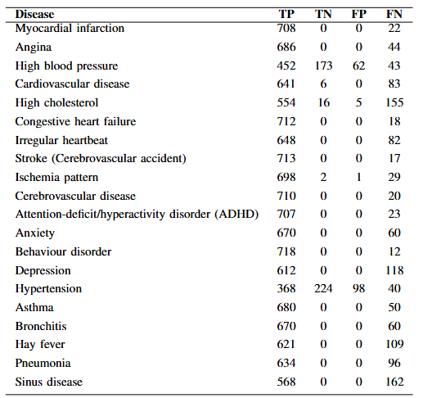
Performance Evaluations (Lightweight Architecture)
3. Confusion Matrices

Slide 24
Result Analysis
Chronic vs Acute: Excellent performance on chronic conditions (hypertension, high BP, bronchitis)
Disease Cohort | Avg ROC-AUC | Best Performer | Worst Performer | Clinical Insight
Cardiovascular (9) | 0.845 | MI (0.907) | Irregular HB (0.745) | ECG features highly discriminative
Mental Health (6) | 0.769 | Cerebrovascular (0.852) | ADHD (0.618) | EEG patterns detectable but complex
Respiratory (5) | 0.699 | Bronchitis (0.783) | Asthma (0.663) | Respiratory signals provide good separation

Slide 25
Limitations
Class​‍​‌‍​‍‌ Imbalance Sensitivity: The effectiveness of the system goes down for rare comorbidities (like myocardial infarction, stroke) as the number of positives is very low.
Bias toward Majority Classes: The NAS search goal is to increase the overall accuracy, hence the result is that the model is mostly tuned on the majority of the frequent disease labels in the multi-label settings.
Reduced Sensitivity for Rare Events: Overall, the framework is highly efficient and accurate, but it exhibits lower recall for rare acute ​‍​‌‍​‍‌conditions.

Slide 26
Phase 2 Plan
Data Expansion & Validation: Integrate large multi-center cohorts (WSC, SHHS, MESA, APPLES, MrOS) to improve robustness, address class imbalance, and enhance cross-cohort generalization.
Clinical Desktop Application: Develop a user-friendly desktop tool enabling clinicians to upload raw EDF files and receive automated risk assessments without requiring Python expertise.
Deployment & Packaging: Package the optimized model and application into a single executable for seamless installation on standard clinical workstations, including low-end systems.

Slide 27
References(APA Style)
Kim, Y., Jang, T. G., Park, S. Y., Park, H. Y., Lee, J. A., Oyun-Erdene, T., ... & Urtnasan, E. (2025). Multimodal AI-approach for the automatic screening of cardiovascular diseases based on nocturnal physiological signals. npj Cardiovascular Health, 2(1), 15.
Lee, H., Choi, Y. R., Lee, H. K., Jeong, J., Hong, J., Shin, H. W., & Kim, H. S. (2025). Explainable vision transformer for automatic visual sleep staging on multimodal PSG signals. npj Digital Medicine, 8(1), 55.
Zhang, Z., Lin, B. S., Peng, C. W., & Lin, B. S. (2024). Multi-modal sleep stage classification with two-stream encoder-decoder. IEEE Transactions on Neural Systems and Rehabilitation Engineering, 32, 2096-2105.
Liu, R., Li, J., Wen, Y., Huang, X., Sheng, B., Feng, D. D., & Zhang, P. (2025). MHFNet: a multimodal hybrid-embedding fusion network for automatic sleep staging. IEEE Journal of Biomedical and Health Informatics.
Jiang, X., Zhao, J., Du, B., & Yuan, Z. (2021, July). Self-supervised contrastive learning for EEG-based sleep staging. In 2021 International Joint Conference on Neural Networks (IJCNN) (pp. 1-8). IEEE.

Slide 28
References(APA Style)
Weng, W., Gu, Y., Guo, S., Ma, Y., Yang, Z., Liu, Y., & Chen, Y. (2025). Self-supervised learning for electroencephalogram: A systematic survey. ACM Computing Surveys, 57(12), 1-38.
LeCun, Y., Bengio, Y., & Hinton, G. (2015). Deep learning. nature, 521(7553), 436-444.
Nie, G., Chen, X., Wang, Y., Chen, J., Shi, Y., Zhong, J., ... & Leng, Y. (2025). A Zero-Burden Sleep Foundation Model Built on Cardiorespiratory Signals from 800,000+ Hours of Multi-Ethnic Sleep Recordings. medRxiv, 2025-09.
Kjaer, M. R., Thapa, R., Ganjoo, G., Moore IV, H., Jennum, P. J., Westover, B. M., ... & Brink-Kjaer, A. (2025). Stanford Sleep Bench: Evaluating Polysomnography Pre-training Methods for Sleep Foundation Models. arXiv preprint arXiv:2512.09591.
Thapa, R., Kjær, M. R., He, B., Covert, I., Moore, H., Hanif, U., ... & Zou, J. (2025). A multimodal sleep foundation model developed with 500k hours of sleep recordings for disease predictions. medRxiv.

Slide 29
References(APA Style)
Weng, W., Gu, Y., Guo, S., Ma, Y., Yang, Z., Liu, Y., & Chen, Y. (2025). Self-supervised learning for electroencephalogram: A systematic survey. ACM Computing Surveys, 57(12), 1-38.
LeCun, Y., Bengio, Y., & Hinton, G. (2015). Deep learning. nature, 521(7553), 436-444.
Nie, G., Chen, X., Wang, Y., Chen, J., Shi, Y., Zhong, J., ... & Leng, Y. (2025). A Zero-Burden Sleep Foundation Model Built on Cardiorespiratory Signals from 800,000+ Hours of Multi-Ethnic Sleep Recordings. medRxiv, 2025-09.
Kjaer, M. R., Thapa, R., Ganjoo, G., Moore IV, H., Jennum, P. J., Westover, B. M., ... & Brink-Kjaer, A. (2025). Stanford Sleep Bench: Evaluating Polysomnography Pre-training Methods for Sleep Foundation Models. arXiv preprint arXiv:2512.09591.
Thapa, R., Kjær, M. R., He, B., Covert, I., Moore, H., Hanif, U., ... & Zou, J. (2025). A multimodal sleep foundation model developed with 500k hours of sleep recordings for disease predictions. medRxiv.

Slide 30
References(APA Style)
Bilal, E., Araujo, M. L. D., Beck, K. L., Heinzinger, C. M., Ghosn, S., Saab, C. Y., ... & Mehra, R. (2025). A Foundation Model for Sleep-Based Risk Stratification and Clinical Outcomes. Research Square, rs-3.
He, Z., Li, H., Yuan, G., Killgore, W. D., Quan, S. F., Chen, C. X., & Li, A. (2025). Multimodal Cardiovascular Risk Profiling Using Self-Supervised Learning of Polysomnography. SLEEPJ, zsaf371.
Manimaran, G., Puthusserypady, S., Dominguez, H., & Bardram, J. E. (2025). Cardiovascular Risk Assessment via Sleep Patterns and ECG-Based Biological Age Estimation. Journal of Clinical Medicine, 14(10), 3339.
Blanchard, M., Feuilloy, M., Gervès-Pinquié, C., Trzepizur, W., Meslier, N., Goupil, F., ... & ERMES study group. (2021). Cardiovascular risk and mortality prediction in patients suspected of sleep apnea: a model based on an artificial intelligence system. Physiological Measurement, 42(10), 105010.
Fallmann, S., & Chen, L. (2018, November). Detecting chronic diseases from sleep-wake behaviour and clinical features. In 2018 5th international conference on systems and informatics (ICSAI) (pp. 1076-1084). IEEE.

